Slide 1
Hardware CWE™ Special Interest Group (SIG)
Gananand Kini, Luke Malinowski, Chris Lathrop, Bob Heinemann, Steve Christey Coley, Alec Summers
MITRE
March 18, 2022

Slide 2
Agenda
Housekeeping
Announcements
Working Items for this meeting:
Progress reports on external collaborations
Optimizing New Content Submissions to CWE
Topics to discuss on the mailing list
Hardware Description Language in Language enumeration

Slide 3
Housekeeping
Schedule:
Next Meeting – Friday, April 15
12:30 – 1:30 PM EST
Microsoft Teams
Contact: cwe@mitre.org
Mailing List: hw-cwe-special-interest-group-sig-list@mitre.org
Did you receive an email on the mailing list regarding “HW CWE Collaboration Tools” on March 10, 2022? If not, please let us know …
Minutes from previous meetings available on our Github site:
https://github.com/CWE-CAPEC/hw-cwe-sig

Slide 4
Announcements
CWE/CAPEC REST API Working Group to form
Announcement with invitation should be in your email
ICS/OT Special Interest Group to form
For the above two working groups, the mailing lists, meeting schedules, etc. are TBD
CWE 4.7 to be released early April

Slide 5
Topic #1
Progress Reports on External Collaborations

Slide 6
Progress Reports - Collaborations
Submissions by Paul Wortman
Reviewed a draft of thesis regarding the categorization and potential new areas for Hardware CWE. Submissions are still under review.
SAE G-32 submissions (counterfeit/anti-tamper/etc.)
Discussed concerns regarding the inclusion of material with intellectual property restrictions as per CWE’s Terms Of Use.
Upcoming CWE 4.7 release
May include some hardware entries
Some entries related to architecture/design from ICS/OT SIG

Slide 7
Topic #2
Optimizing Submission Handling

Slide 8
Goal: Optimize the Submission Process
We want to operationalize turning “submissions” into live CWE entries
We do not have the kinds of complete submissions that we did in the early days of hardware CWE
… and even those required a lot of modification (which we’re still managing today)
Our quality review process is becoming more comprehensive
We want to:
Better characterize issues with submissions
Track each “stage” better
Be more transparent

Slide 9
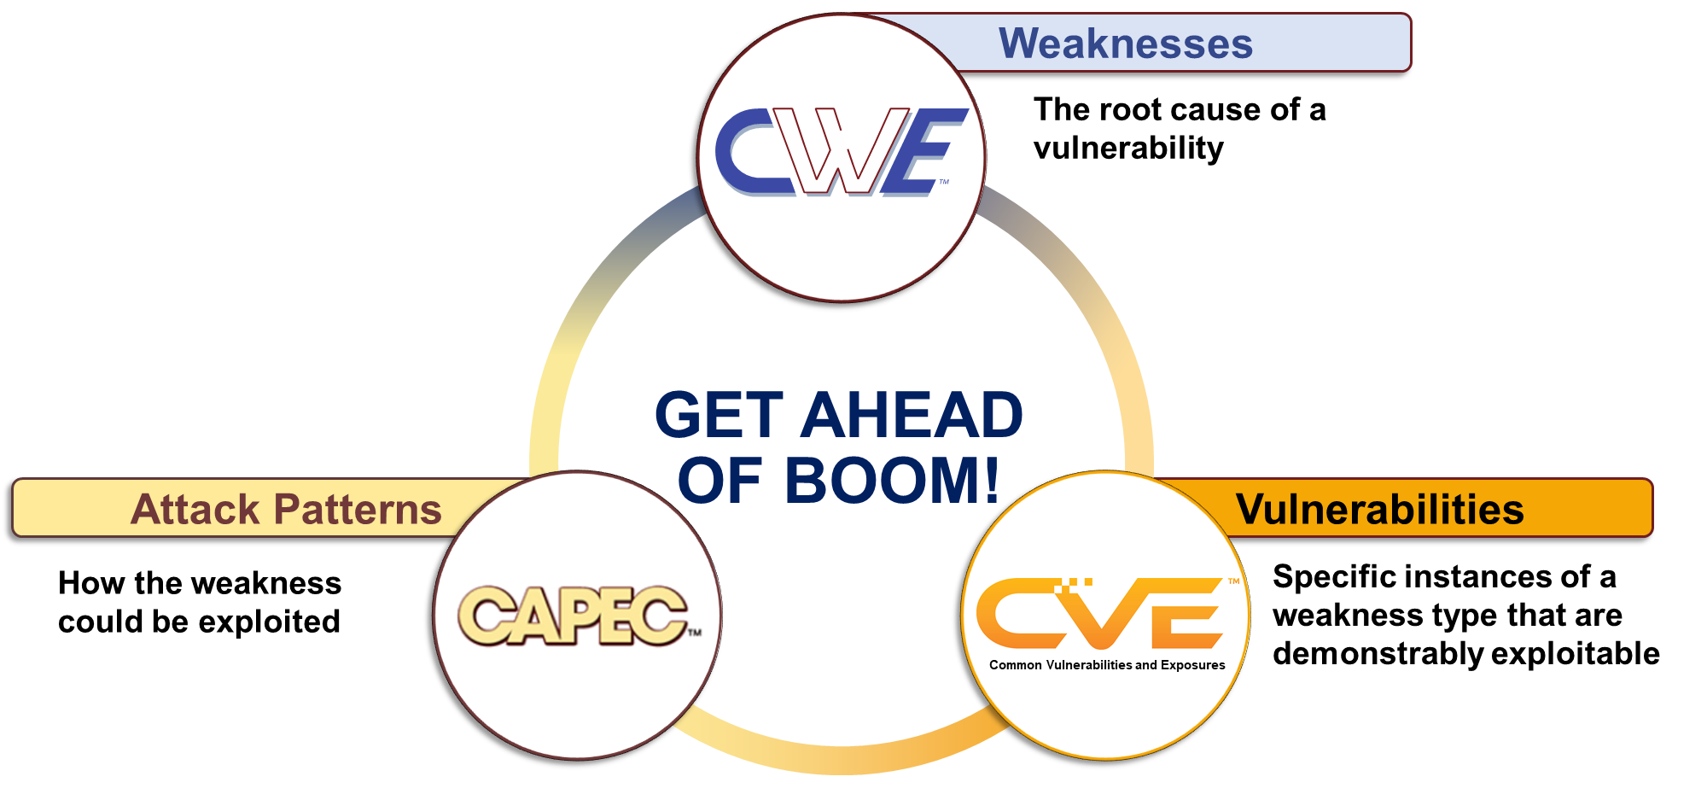
‘Get Ahead of Boom’ Landscape

Slide 10
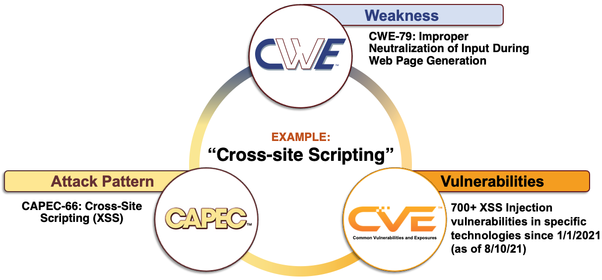
‘Get Ahead of Boom’ Landscape
Notes:
One of the most well-known security issues is that of Cross-site Scripting, which was actually the #1 entry in last year’s Top 25 List. For those unfamiliar, the top 25 list of most dangerous software weaknesses is a list the CWE program publishes annually that leverages publicly-disclosed cve data within the national vulnerability database to generate a list of the most dangerous software weaknesses. Our methodology is a data-driven process that accounts for how prevalent a weakness is within the dataset, as well as the relative severity of each instance by way of accompanying cvss scores. So the #1 on our list last year was what is commonly referred to as ‘Cross-site scripting’, or rather the weakness that allows cross-site scripting to occur… and that is that the software does not neutralize or incorrectly neutralizes user-controllable input before it is placed in output used as a web page that served to other users
So using this example to understand the relationship between CWE, CVE, and CAPEC, CWE describes the underlying weakness that allows this situation to arise: that is, the improper neutralization of input during web page generation.
CAPEC contains an entry describing the specific process, or attack pattern, an adversary might take to exploit this weakness.
And as of this week, CVE has well over 700 cross site scripting vulnerabilities in various technologies in 2021 so far
NEXT SLIDE

Slide 11
CWE Submission Stages (In Progress)
Idea
Submitted: Contributor provides limited submission to MITRE
Past: full templates. Future: submission server
Received: Contributor submits new content/idea, receives tracking ID
Review
a. Acknowledged as a weakness
b. Within scope
c. Appropriate abstraction
d. Not a duplicate / overlap
Full submission (using submission template with ~14 elements)
Editing / External Review
Publication
Modification / Enhancement
Submission Guidelines (with different stages) - https://cwe.mitre.org/community/submissions/guidelines.html

Slide 12
Common Problems Affecting Integration into CWE
Submission is not Weakness-focused
Descriptions are not clearly written
Submission is not within CWE’s current scope
Not all requested information is provided
Submission elements are missing or do not follow guidelines
Proprietary or non-publicly accessible content
Submission requires additional research to include
Submission requires CWE reorganization

Slide 13
Defining CWE Scope – a First Attempt
Primary scope: “mistakes in behavior of software or other electronic logic that has been shown - or can be reasonably expected – to contribute to real-world vulnerabilities”
Focus: any measurable or analyzable artifact related to design, architecture, or other phase that (1) enables the introduction or (2) prevents the detection of weaknesses
Scope expansion might require Board/HW-SIG/public debate

Slide 14
Scope – Potential Exclusions
Clarify commonly-seen problems in CWE submissions
Focus discussion and debate
Such items cannot receive a CWE ID, but might be captured within fields
 | Description
1 | Any mistake that has not and cannot happen within real-world software or other electronic logic.
2 | Any human or organizational process or policy that is not measurable and does not produce clear artifacts that identify weaknesses, such as training or testing. Rationale: weaknesses can emerge as a result of these activities; BSIMM, OpenSAMM, etc. already cover this area.
3 | Any characterization of motivation (e.g., “malicious”) that does not focus on the actual mistake, whether intentionally or accidentally introduced. Rationale: a weakness is based on the behavior of the product.
4 | Conditions or situations in which weaknesses are more likely to appear. Rationale: these are modes of introduction, which is a separate field in a CWE entry.

Slide 15
Scope – More Potential Exclusions
Are there other exclusions to add?
 | Description
5 | Any collection of groupings related to the same technology, same language, development lifecycle, etc., without a common behavior. Rationale: weaknesses are based on specific behavior. Such items could be a category.
6 | There is no actionable mitigation available to the developer to prevent or reduce the weakness
7 | The issue is not relevant to the threat model / security concerns of product’s owner/operator (i.e., the customer)

Slide 16
Characterizing Complications
Even if a submission describes a weakness, it may be difficult and time-consuming to integrate it into CWE
Each submission might be labeled with one or more “complications” to facilitate tracking
 | Description
1 | Duplicates or partial overlaps with existing weaknesses, either indicating problems with the submission, existing CWE entries, or CWE’s “vulnerability theory” model of weaknesses
2 | Abstraction is either too high-level or too low-level
3 | Weakness not well-described (lots of back-and-forth)
4 | Bare-bones submissions (team has to create or provide lots of extra data)
5 | Concerns with intellectual property rights

Slide 17
Topic #3
Topics to discuss on the mailing list

Slide 18
Topics for resolution on Mailing List
hw-cwe-special-interest-group-sig-list@mitre.org
The following previously discussed topics can be moved to the mailing list:
Suggestions for Technology Name enumeration
Suggestions for Technology Class enumeration
Distinction in weaknesses between Hardware or Software

Slide 19
Topic #4
Hardware Description as a Language Class

Slide 20
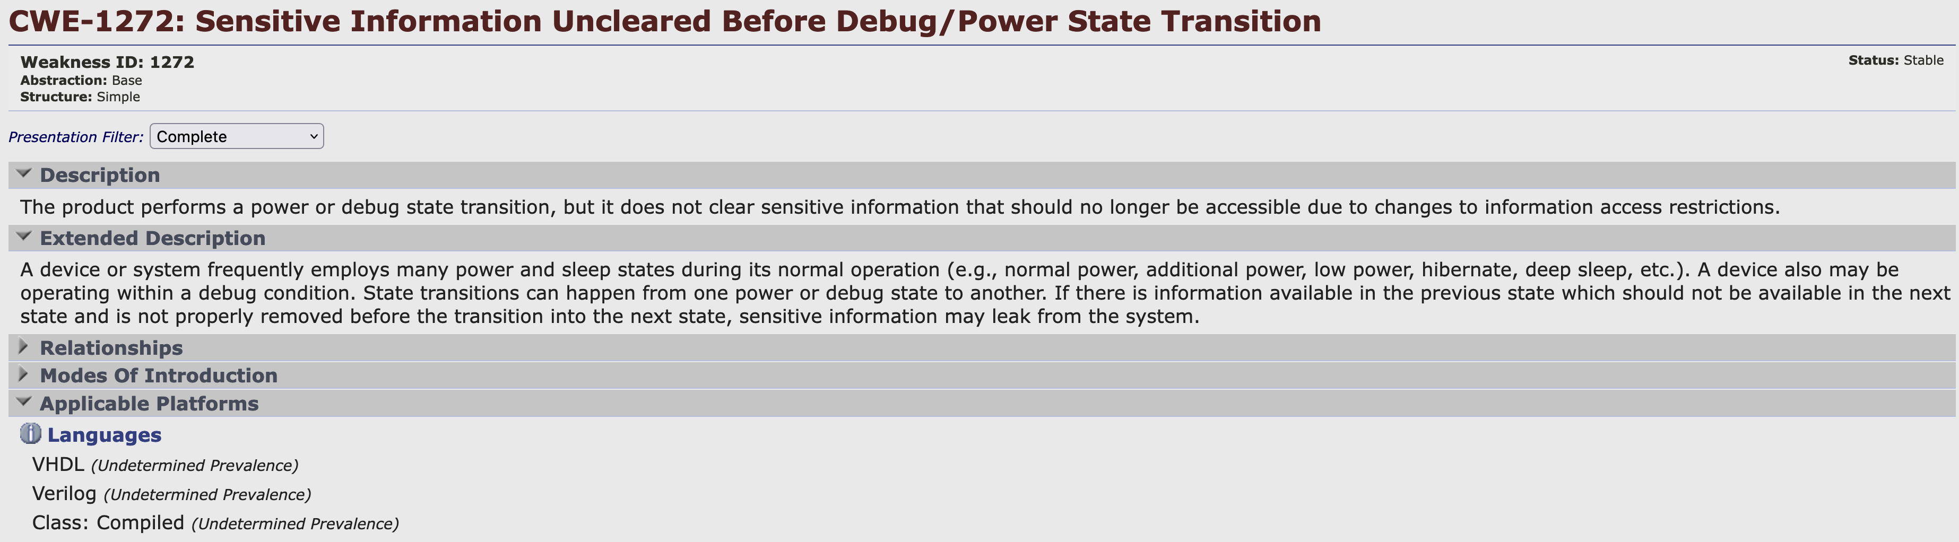
Hardware Description as a Language Class
Hardware Description Language Class

Slide 21
Next Meeting (April 15)
Mailing List: hw-cwe-special-interest-group-sig-list@mitre.org
What would members of this body like to see for the next HW SIG agenda?
Questions, Requests to present? Please let us know.
CWE@MITRE.ORG

